Slide 1
JUnit Programming Concept

Slide 2
Module Overview
In this Module, we will understand the following:
Writing a Tests
Using Assertion
Execution Procedure
Executing Tests
Suite Test
Ignore Test
Time Test
Exceptions Test
Parameterized Test
Plug with Ant
Plug with Eclipse
Extensions

Slide 3
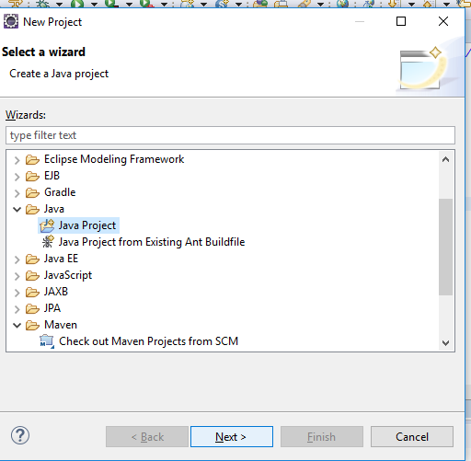
How To Write Testcase In Junit
Demo: Writing a Test Duration:10 min
Create a New Java Project and name it
Notes:
https://j2eedev.org/junit-beginer-tutorial/
Change the demo package name & write code replace screenshot.

Slide 4
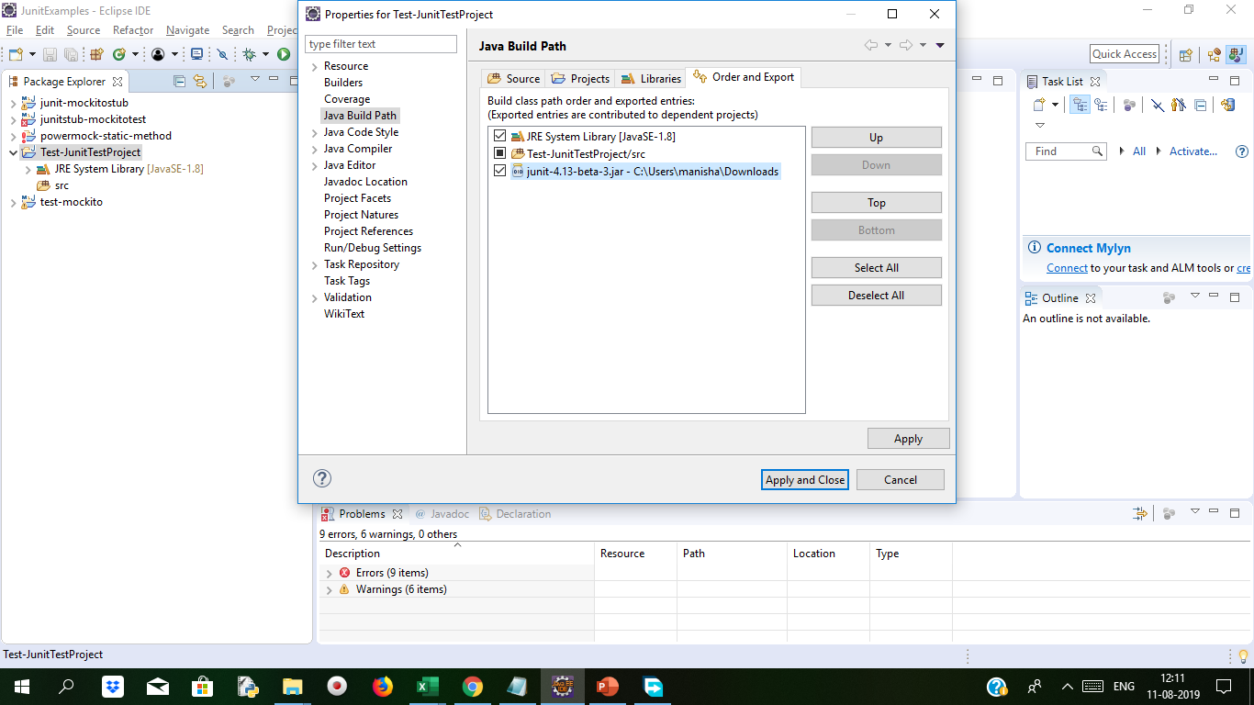
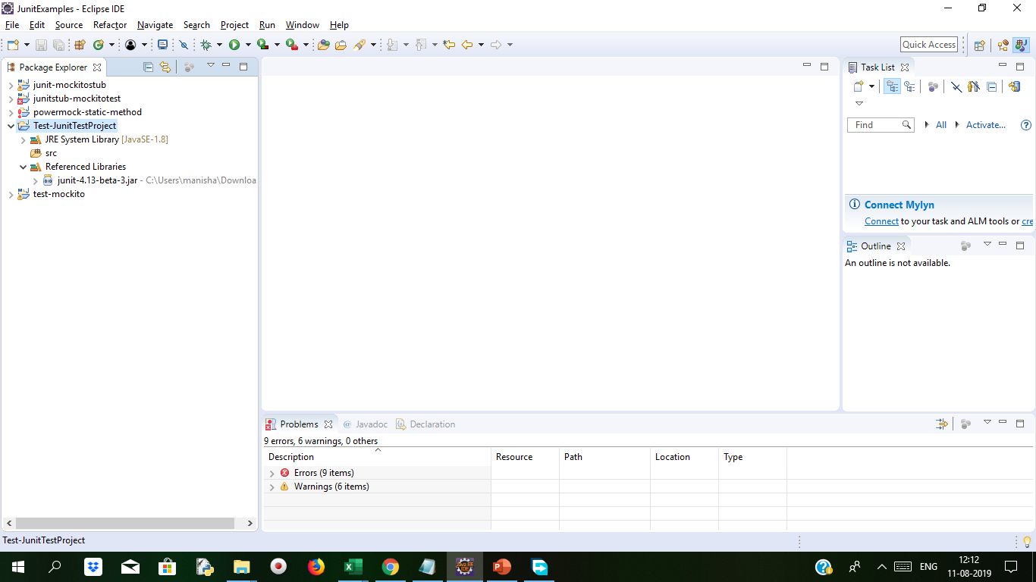
Demo: Writing a Test Cont..
For error generated from test case code in java file, take cursor on it.
And Add path from properties→ Build Path → Add Library → Add Junit Library.

Slide 5
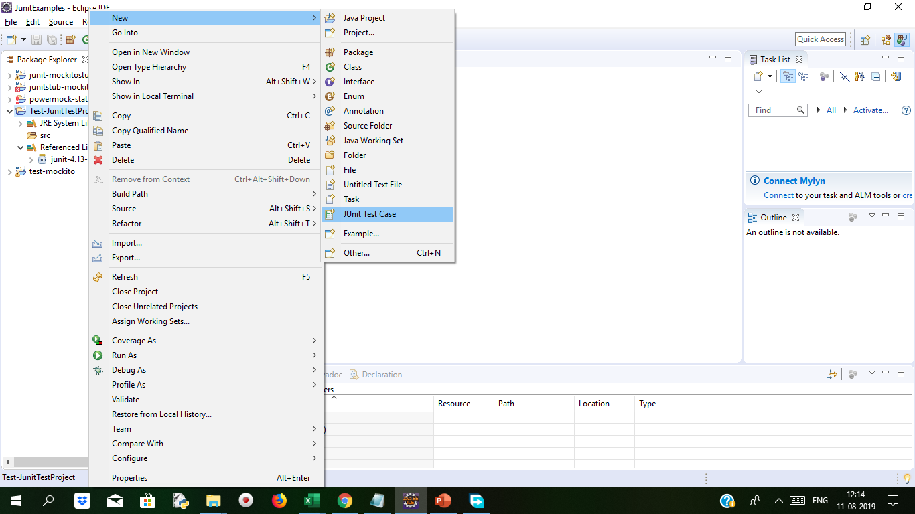
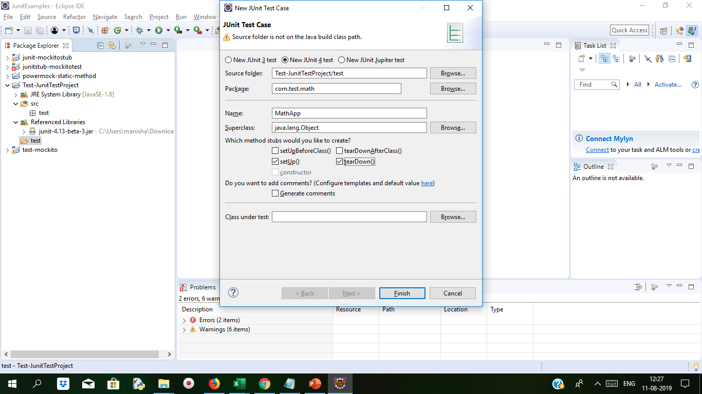
Demo: Writing a Test Cont..
Select package name and name the TestCase name as MathApp
Create new Junit Test Case

Slide 6
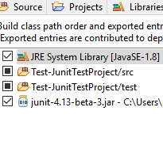
Demo: Writing a Test Cont..
If Class path is not set to test package configure it via build path libraries
Create MathApp which extends TestCase
import static org.junit.Assert.*;
import org.junit.After;
import org.junit.Before;
import org.junit.Test;
import junit.framework.TestCase;
import math.Calculation;
public class MathApp extends TestCase {
private int value1;
private int value2;
public MathApp(String testName) {
super(testName);
}
protected void setUp() throws Exception {
super.setUp();
value1 = 3;
value2 = 5;
}
protected void tearDown() throws Exception {
super.tearDown();
value1 = 0;
value2 = 0;
}
public void testAdd() {
int total = 8;
int sum = Calculation.add(value1, value2);
assertEquals(sum, total);
}
Create Calculation.java file
package math;
public class Calculation {
public static int add(int a, int b) {
return a + b;
}
public static int sub(int a, int b) {
return a - b;
}
}

Slide 7
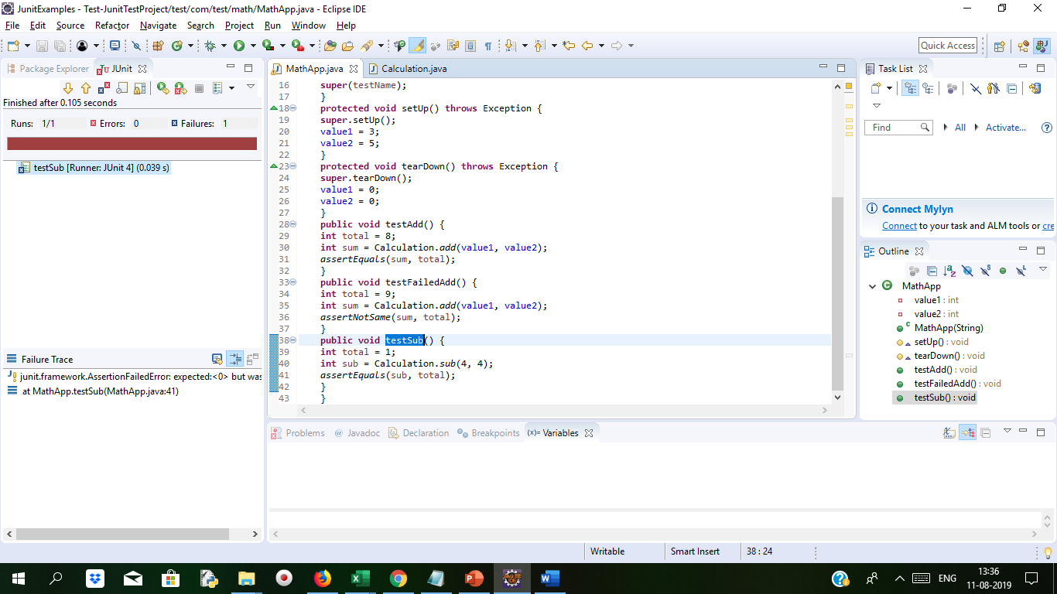
Demo: Writing a Test Cont..
public void testFailedAdd() {
int total = 9;
int sum = Calculation.add(value1, value2);
assertNotSame(sum, total);
}
public void testSub() {
int total = 0;
int sub = Calculation.sub(4, 4);
assertEquals(sub, total);
}
}
There are various methods available
with Assert. We can find the one,
which suites us to test the classes in our application.
We modify the value of total to 1 and if debug the method as junit test then we get failure result.

Slide 8
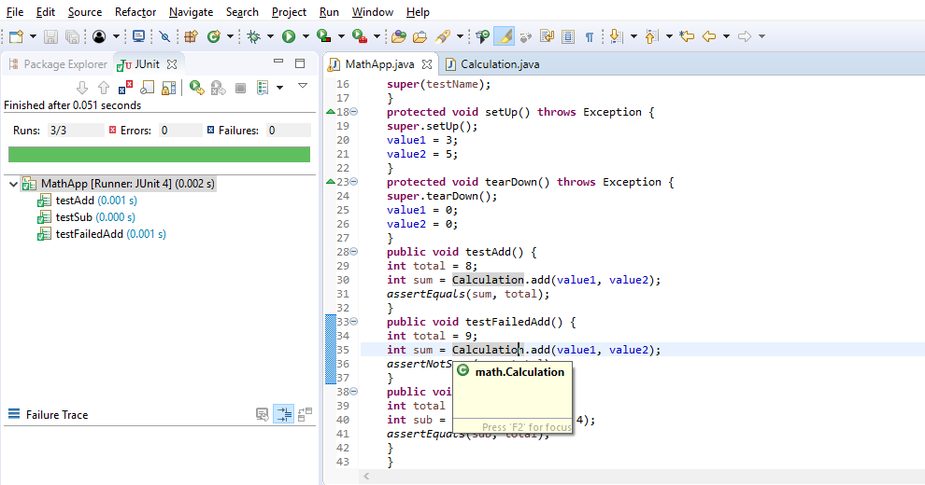
Demo: Writing a Test Cont..
Output

Slide 9
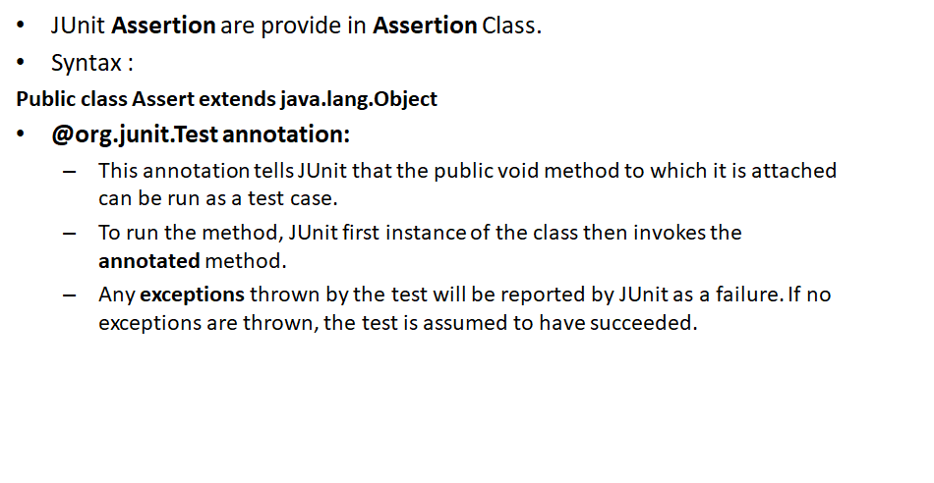
JUnit Using Assertion

Slide 10
Assertion Methods
Method | Description
assertEquals() | Check that two objects are equal or not.
assertTrue() | Check that Given condition is true or Not
assertFalse() | Check that Given condition is false or Not
assertNotNull() | Check Given Object is not null
assertNull(Object object) | Check that Given object is null
assertSame() | Check if two objects are same
assertNotSame(object1, object2) | Check if two objects are not same
assertArrayEquals() | Check array is equal or not

Slide 11
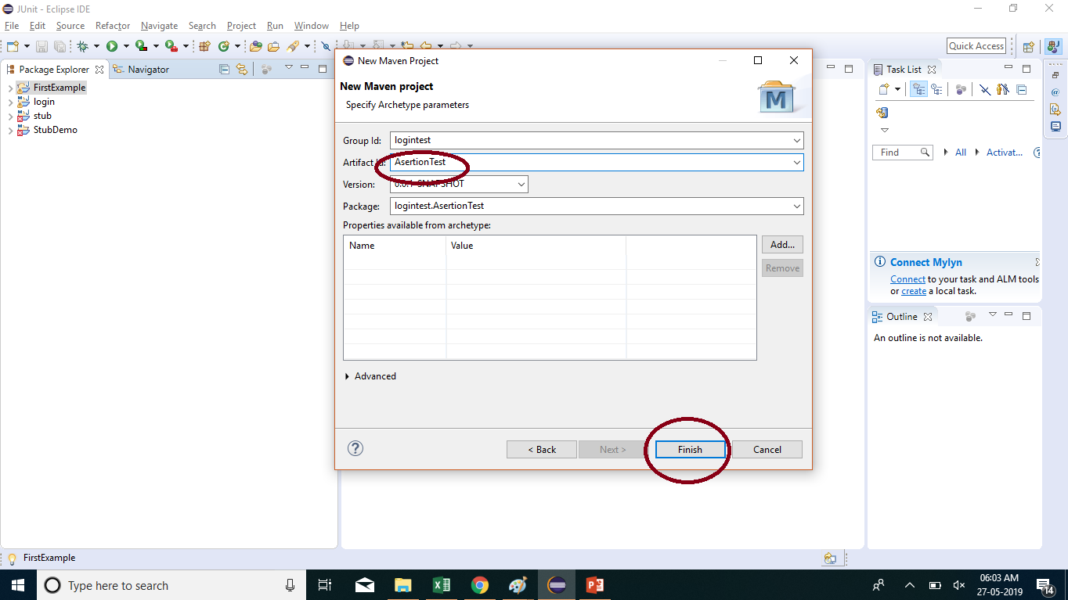
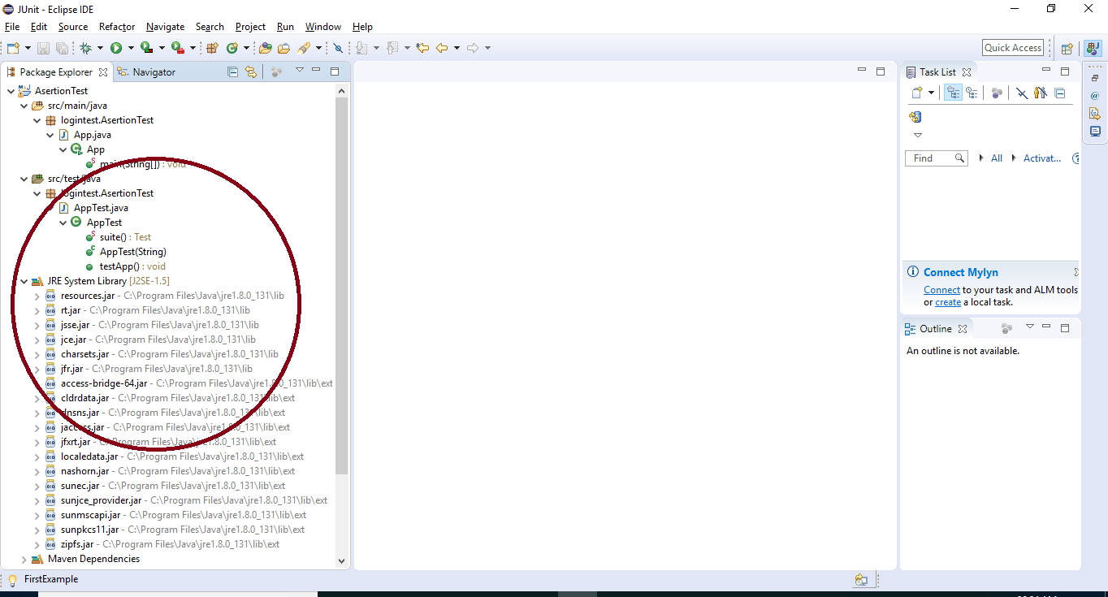
Demo: Assertion Duration:15 min
Create New Project With Maven.
Add all Junit Libraries from build path.
Give project name and click on Finish button.
Following Structure of Project that we can Show in Eclipse.

Slide 12
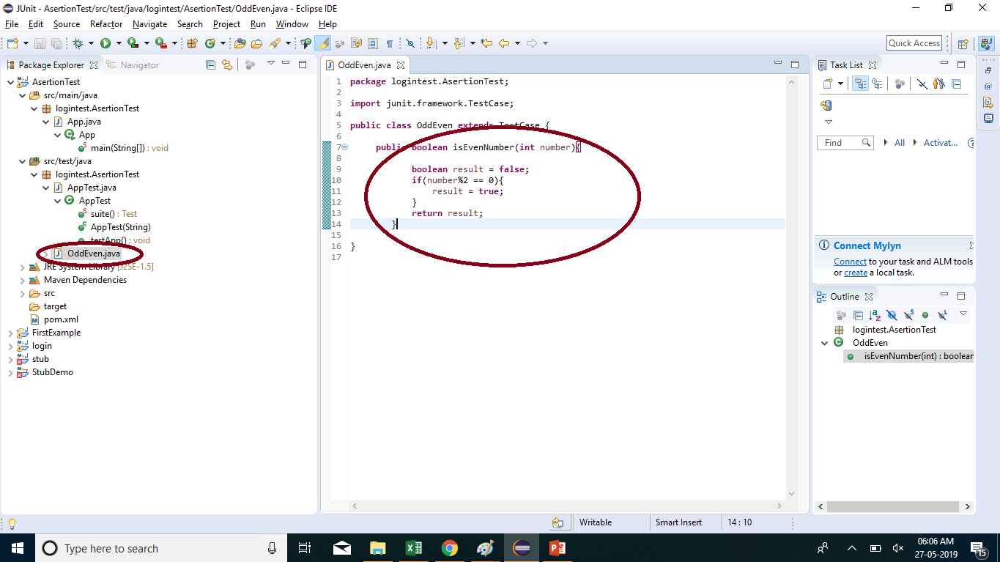
Demo: Assertion Cont..
Create First Class in java and write code in java class.

Slide 13
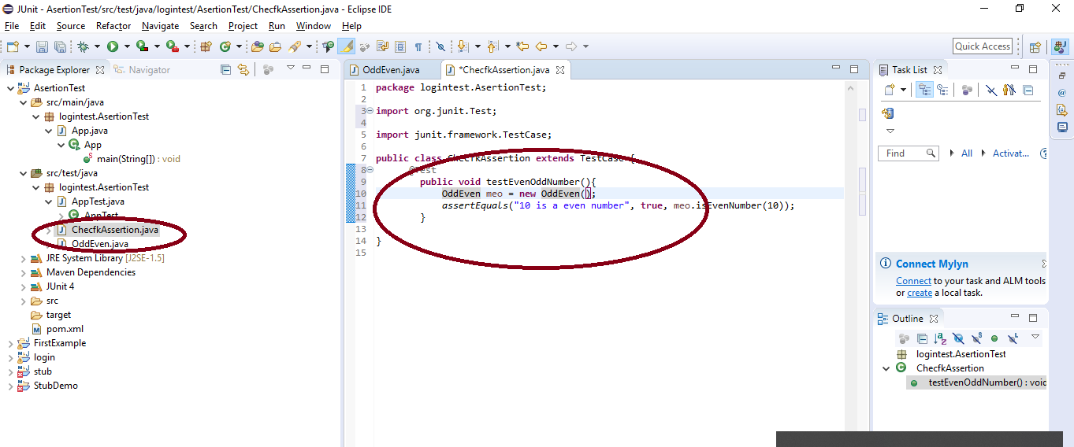
Demo: Assertion Cont..
Create Object of First Class and Use Assertion statement.
write condition in Assertion statement.

Slide 14
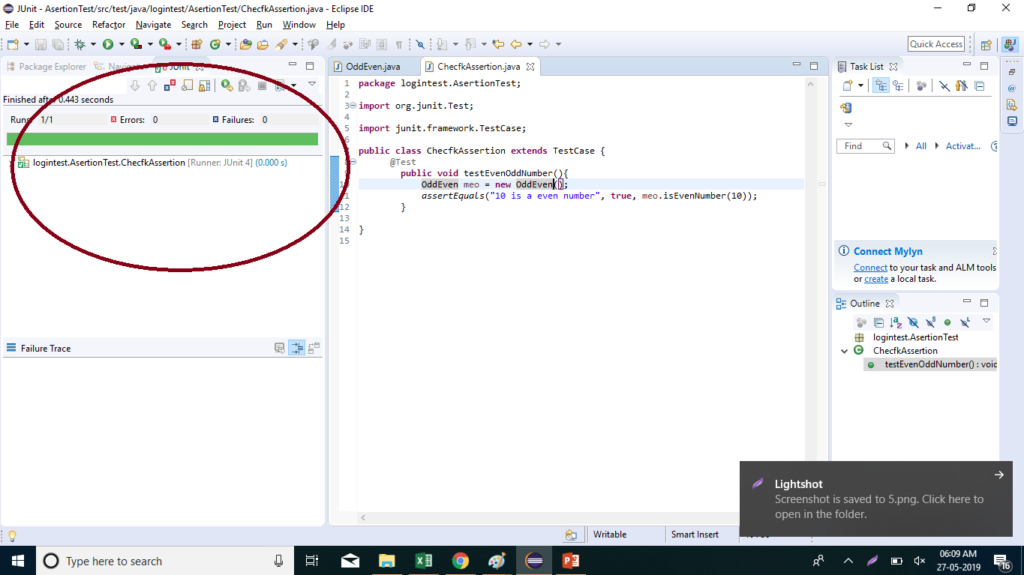
Demo: Assertion Cont..
Following Result We can show when run this testcase with Assertion.

Slide 15
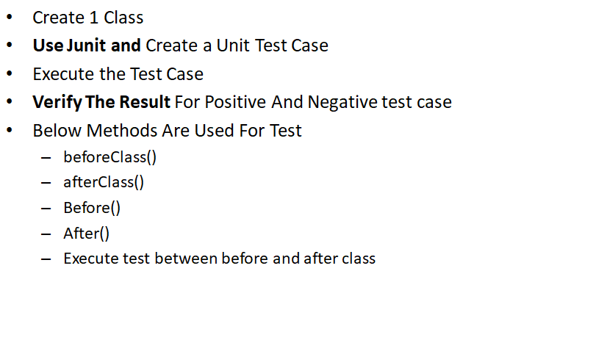
Execution Procedure/Test
Notes:
@BeforeClass: It is used to write code that we want to run before all test cases.
@AfterClass: It is used to write code that we want to run after all test cases.
@Before: It will run before every test case.
@Test: This is actual test case.
@After: It will run after every test case.

Slide 16
Syntax Of Execution Procedure/Test
public class ExecutionProcedureJunit { //execute only once, in the starting @BeforeClass public static void beforeClass() { System.out.println("in before class"); } //execute only once, in the end @AfterClass public static void afterClass() { System.out.println("in after class"); } //execute for each test, before executing test @Before public void before() { System.out.println("in before"); } | //execute for each test, after executing test @After public void after() { System.out.println("in after"); } //test case 1 @Test public void testCase1() { System.out.println("in test case 1"); } //test case 2 @Test public void testCase2() { System.out.println("in test case 2"); } }

Slide 17
Test Suite
In order to run together all test cases from multiple classes, Test Suite is used in JUNIT.
Below Annotations can be used in class to run the test suite. All the test classes will get executed one by one.
@RunWith(Suite.class)
@SuiteClasses(sample1.class,sample2.class…) /
@Suite.SuiteClasses({sample1.class,sample2.class…})
We will use @RunWith and @Suite Annotations and explore more.

Slide 18
Demo: Test Suite Duration: 10 min
Create a class named DemoTest.java. We will use @RunWith & @Suite Annotations in this class.
package demosuitetest.junit
import org.junit.runner.RunWith;
import org.junit.runners.Suite;
@RunWith(Suite.class)
@Suite.SuiteClasses({
SampleSuiteTest1.class,
SampleSuiteTest2.class,
})
public class DemoTest {
// This class will be empty. It will be holder for the above annotations
}

Slide 19
Demo: Test Suite Cont..
2) Create a class named Sample1.java which is used as Suite in DemoTest class.
package demosuitetest.junit;
import static org.junit.Assert.assertEquals;
import org.junit.Test;
public class SampleSuiteTest1 {
public String str = “Tom";
JUnitMessage jm = new JUnitMessage(str);
@Test(expected = ArithmeticException.class)
public void DemoTest1() {
System.out.println(“SampleTest1 Message is printing ");
jm.printMessage();
}
@Test
public void DemoTest2() {
str = “Welcome" + str;
System.out.println(“SampleTest2 Welcome Message is printing ");
assertEquals(str, jm.printCustomMessage());
System.out.println(" SampleSuiteTest2 is successful " + str);
}
}

Slide 20
Demo: Test Suite Cont..
3) Create a class named Sample2.java which is used as Suite in DemoTest class.
package demosuitetest.junit;
import org.junit.Assert;
import org.junit.Test;
public class SampleSuiteTest2 {
@Test
public void createAndSetName() {
String expected = “A";
String actual = “A";
Assert.assertEquals(expected, actual);
System.out.println(“SampleSuiteTest1 is successful " + actual);
}
}

Slide 21
Demo: Test Suite Cont..
Execute the DemoTest.java to get below output:
SampleTest2 Welcome Message is printing
Welcome Tom
SampleSuiteTest2 is successful Welcome Tom
SampleTest1 Message is printing
Tom
SampleSuiteTest1 is successful A
Hence using Automation Testing, user can test data with multiple inputs by aggregating all test cases from various classes.

Slide 22
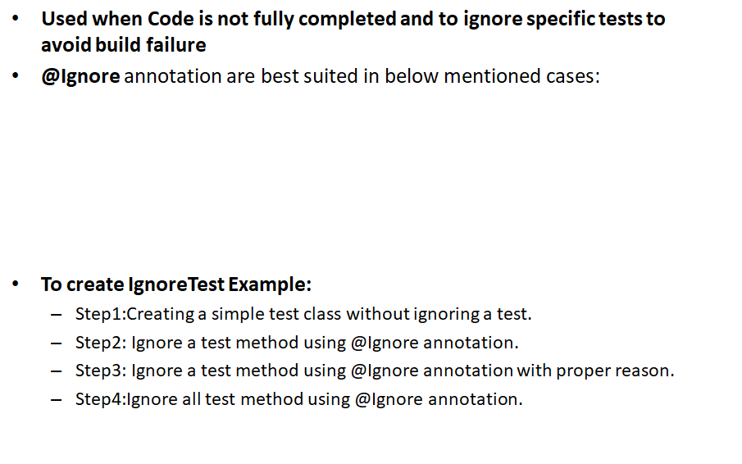
@Ignore annotation
Cases/Scenarios | Description
To ignore a specific test method | Use @Ignore along with @Test annotation.
To ignore all the class tests | At the class level use @Ignore annotation

Slide 23
Ignore Test
Structure Of Ignore Test
import static org.junit.Assert.assertEquals; import org.junit.Ignore; import org.junit.Test; public class JunitTestExample { public String message = “Tom"; JUnitMessage jmsg = new JUnitMessage(message); @Ignore @Test public void CheckMessage() { System.out.println(" Message printing successfully from JUNIT "); assertEquals(message, jmsg.printMessage()); } | @Test public void GreetMessage() { message="Have a nice Day" +message; System.out.println("Junit Greet Message is printing "); assertEquals(message, jmsg.GreetMessage()); } }

Slide 24
Ignore Test Using @ignore annotation
import static org.junit.Assert.assertEquals; import org.junit.Ignore; import org.junit.Test; public class JunitTestDemo { public String message = “User"; JUnitMessage junitMessage = new JUnitMessage(message); @Ignore("not yet ready , Please ignore.") @Test public void testJUnitMessage() { System.out.println(" Hello Message is printing "); | assertEquals(message, junitMessage.printMessage()); } @Test public void testJUnitHiMessage() { message=“Greetings!!" +message; System.out.println(“Hello Greetings !! Message is printing "); assertEquals(message, junitMessage.printHiMessage()); } }

Slide 25
Time Test
A test case is marked failed automatically, if its takes more than the specified milliseconds.
With @Test annotation we will use a parameter called as timeout.
Syntax:
@Test(timeout=1000)
public void testWithTimeout() { ..
}

Slide 26
Demo Duration: 10 min
import org.junit.Rule; import org.junit.Test; import org.junit.rules.Timeout; public class HasGlobalTimeout { public static String log; private final CountDownLatch latch = new CountDownLatch(1); @Rule public Timeout globalTimeout = Timeout.seconds(10); // 10 seconds max per method tested | @Test public void testSleepForTooLong() throws Exception { log += "ran1"; TimeUnit.SECONDS.sleep(100); // sleep for 100 seconds } @Test public void testBlockForever() throws Exception { log += "ran2"; latch.await(); // will block } }

Slide 27
Exception Test
JUnit helps not only in exception tracing but also checks if expected exception is thrown by the code or not.
Exception Testing
Optional parameter (expected) of @test annotation and
To trace the information ,"fail()" can be used
The exception class given in the parameter of @test annotation which is an optional parameter must be same. The test will fail if this condition fails.
Example@Test(expected=IllegalArgumentException.class)

Slide 28
Example
public class JUnitMessage{ private String message; public JUnitMessage(String message) { this.message = message; } public void printMessage(){ System.out.println(message); int divide=1/0; } | public String printHiMessage(){ message="Hi!" + message; System.out.println(message); return message; } }

Slide 29
Parameterized Test
Here the tests are conducted by using various values repeated times.
As only the inputs and results differ, lot of time is saved as far as the work of developer is concerned.
Make a test with various parameters by following below steps:
Class must be with annotation- @RunWith.
The testing data should be defined by a method which is public and static, with @Parameters, This returns an object collection i.e. Array.
Instance variable must be created for every test data column.
Using the test data use the @Parameter annotation for the public fields to retrieve the injected test values injected or a public constructor can be created to 1 testing data row.
Test cases to be created by using the instance variables.

Slide 30
Syntax
// Define the test data @Parameterized.Parameters(name = "{index}: Test with a1={0}, a2 ={1}, result is:{2} ") public static Collection<Object[]> data() { Object[][] data = new Object[][]{{1, 3, 3}, {4, 3, 12}, {100, 4, 400}}; return Arrays.asList(data); }
Notes:
Each row is an input for test.

Slide 31
Demo Duration:10 min
import org.junit.Test; import org.junit.runner.RunWith; import org.junit.runners.Parameterized; import java.util.Arrays; import java.util.Collection; import static org.junit.Assert.assertEquals; @RunWith(Parameterized.class) public class TestParameterized { @Parameterized.Parameter(0) public int a1; @Parameterized.Parameter(1) public int a2; @Parameterized.Parameter(2) public int result; | // creates the test data @Parameterized.Parameters(name = "{index}: Test with a1={0}, a2 ={1}, result is:{2} ") public static Collection<Object[]> data() { Object[][] data = new Object[][]{{1, 3, 3}, {4, 3, 12}, {100, 4, 400}}; return Arrays.asList(data); } @Test public void TestingMultiply() { TestingClass tc = new TestingClass(); assertEquals("Result", result, tc.multiply(a1, a2)); } // class to be tested private class TestingClass { public int multiply(int x, int y) { return x * y; } } }

Slide 32
ANT Plugin
Ant is mainly used for building Java applications.
Various built-in tasks are supplied which helps in compiling, assembling, testing and running Java applications.
Notes:
Apache Ant definition as per website-https://ant.apache.org/
Apache Ant is a Java library and command-line tool whose mission is to drive processes described in build files as targets and extension points dependent upon each other

Slide 33
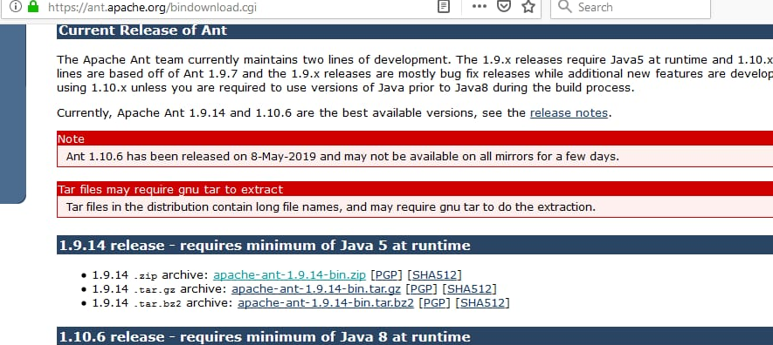
Configure Ant Duration: 15 min
Download Ant from below website as per your java runtime.
http://ant.apache.org/bindownload.cgi

Slide 34
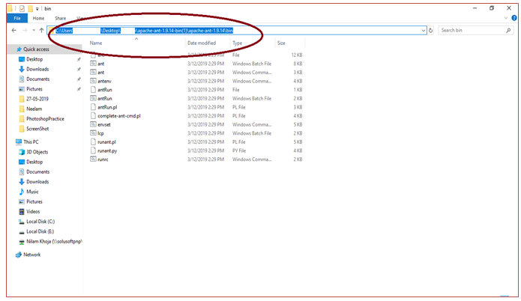
Set Path Of Ant
Take path of ANT →bin folder

Slide 35
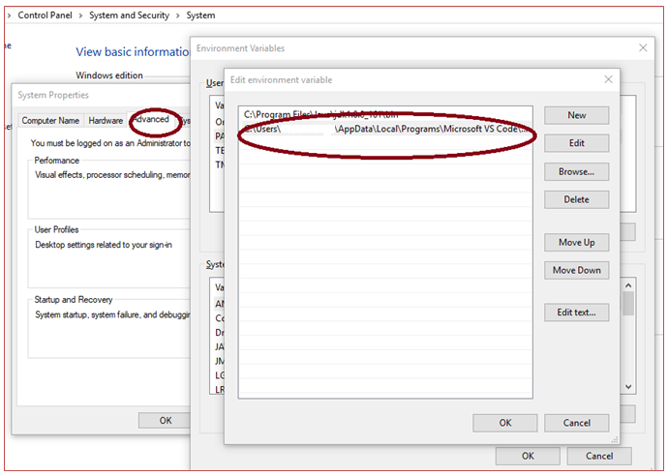
Set Environment Variable
Copy that path and edit it in Environment variable

Slide 36
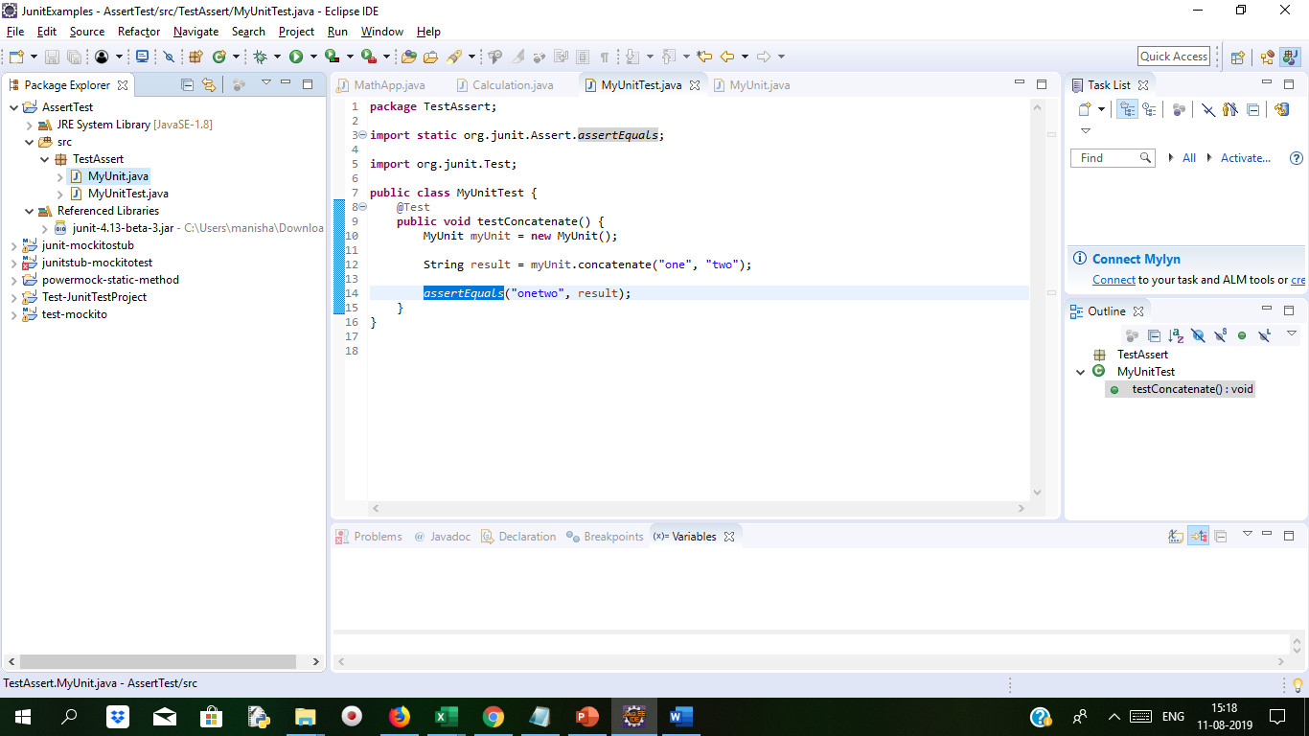
Test with Junit
Project Structure and MyUnit.java file, MyUnitTest.java file as below
package TestAssert;
import static org.junit.Assert.assertEquals;
import org.junit.Test;
public class MyUnitTest {
@Test
public void testConcatenate() {
MyUnit myUnit = new MyUnit();
String result = myUnit.concatenate(“one", "two");
assertEquals("onetwo", result);
}
}
package TestAssert;
public class MyUnit {
public String concatenate(String string, String string2) {
// TODO Auto-generated method stub
return string+string2;
}}

Slide 37
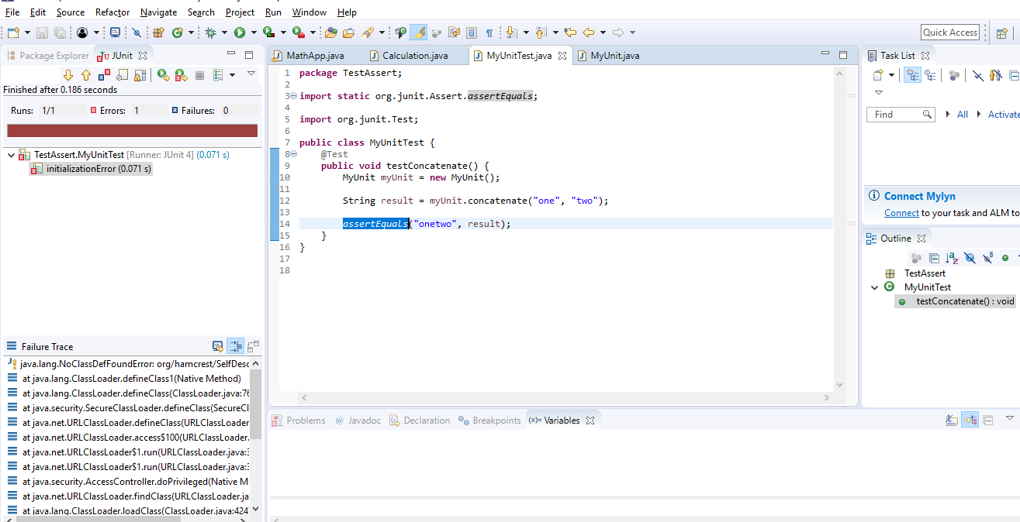
Test with Junit
This demo explained here is comparing to String objects. The assertEquals() method can use to compare any two objects to each
other. The assertEquals() method also come in various syntax which compare primitive types like int and float to each other.

Slide 38
Eclipse and Plug With it
PART 1) Install Java
PART 2) Download JUnit
Notes:
Note Some of these steps are already done in 1st Module JUNIT_Concepts and can be ignored.
But make sure you have JUNIT jar files configured.

Slide 39
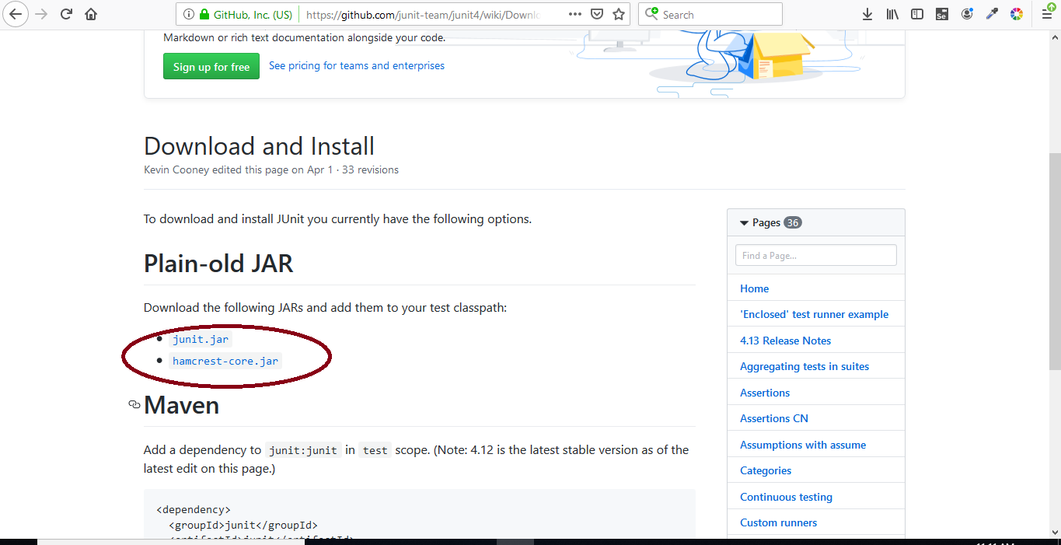
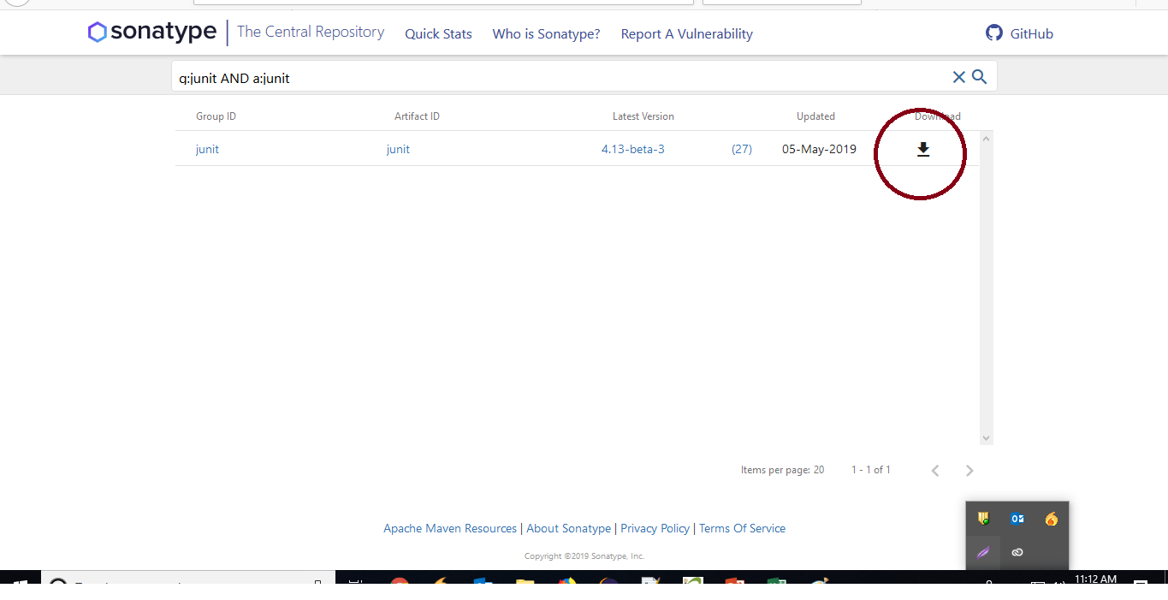
Cont..
Step 2) Click junit.jar

Slide 40
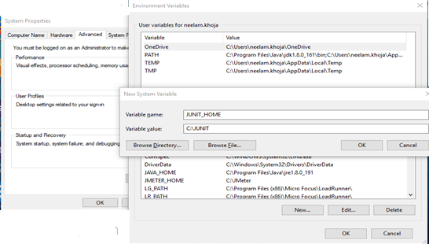
JUnit Environment Setup
PART 3) JUnit Environment Setup
Step 1) You need to set JUNIT_HOME environment variable to point out the base location where you have placed JUnit Jars.
open system properties->advanced ->environment variable.

Slide 41
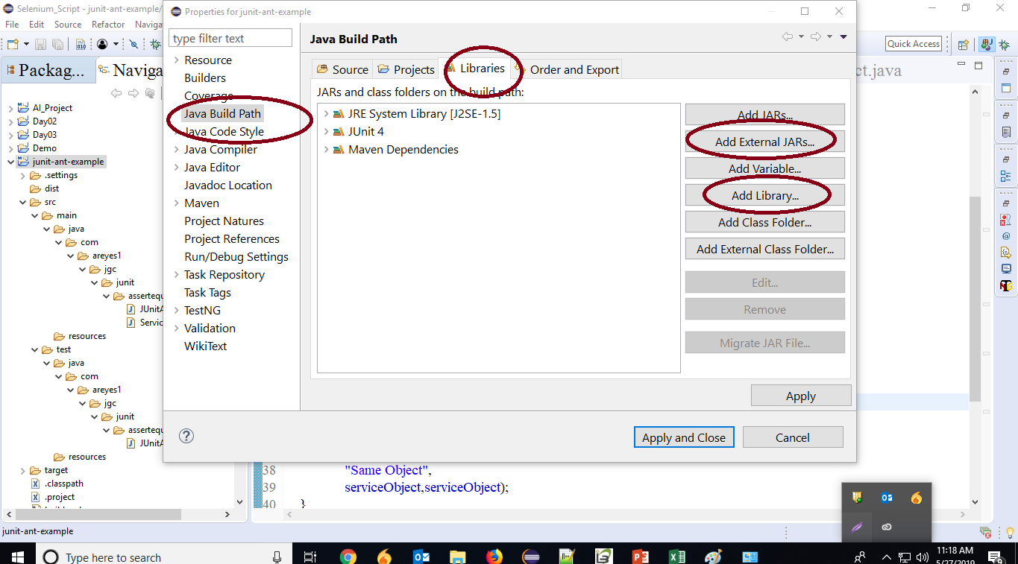
Install JUnit jar file in eclipse
PART 4) Install JUnit jar file in eclipse
Click on "build path" and then
Click on "Configure build path".

Slide 42
Junit Extension
JUnit extensions are−
Cactus
JWebUnit
XMLUnit
MockObject
Cactus Framework
The use of Cactus, a simple test framework is for unit testing server-side java code (Servlets, EJBs, Tag Libs, Filters, ...).
The main purpose of Cactus is to help in reducing the cost of writing tests for server-side code.
Cactus uses JUnit and also extends it.
Cactus supports in-Container pattern tests means are executed inside the container.

Slide 43
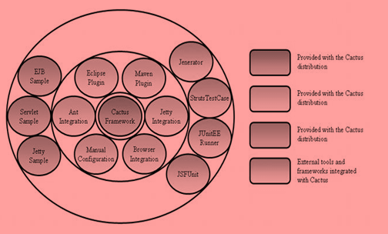
Junit Extension(Cactus)
The Cactus Ecosystem is made of several components:
The Cactus Framework: It is known as the heart of Cactus. Also it is the engine that provides the API to write Cactus tests.
The Cactus Integration Modules: Ant scripts, Eclipse plugin, Maven plugin etc...these are front ends tools and frameworks library which provide easy methods to use cactus framework.
The Cactus Samples: These are simple projects that shows how to code Cactus tests and how to use the Integration Modules.

Slide 44
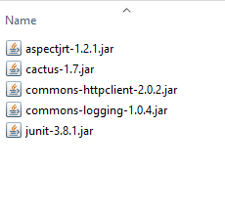
Cactus Framework Example Duration:15 min
Let us understand Cactus Framework how helps in testing by writing a test case.
Create New Junit TestCase Project in Eclipse=>
Add below libraries to class path library

Slide 45
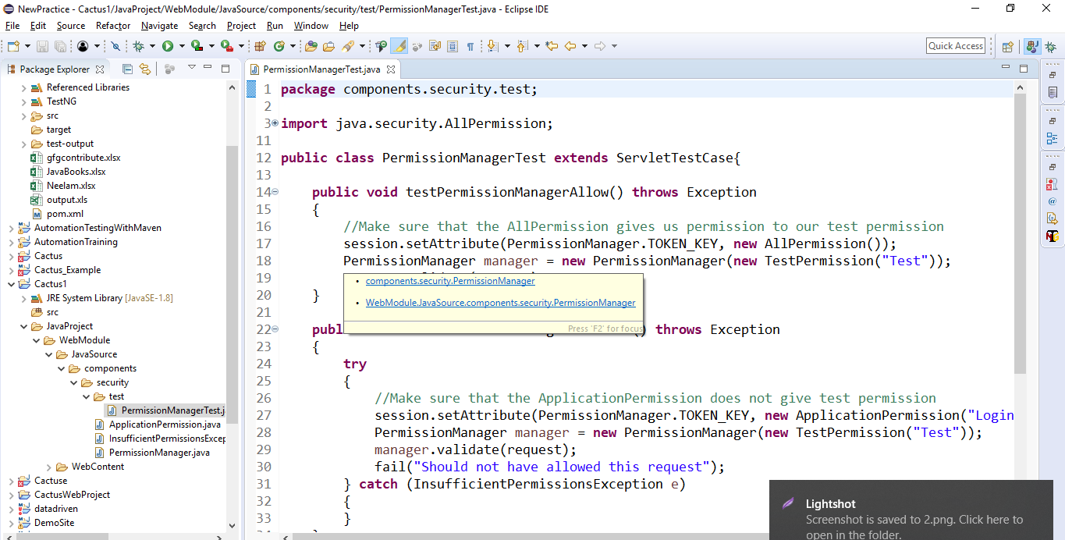
Cactus Example
Cactus Framework Example
In above code we created PermissionManager’s manager object and manager is calling validate() method testPermissionManagerAllow() and testPermissionManagerDisallow() method are used to check valid permission.
Notes:
Below is the code for PermissionManagerTest.java code
package components.security.test;
import java.security.AllPermission;
import java.security.BasicPermission;
import org.apache.cactus.ServletTestCase;
import components.security.ApplicationPermission;
import components.security.InsufficientPermissionsException;
import components.security.PermissionManager;
public class PermissionManagerTest extends ServletTestCase{
public void testPermissionManagerAllow() throws Exception
{
//Make sure that the AllPermission gives us permission to our test permission
session.setAttribute(PermissionManager.TOKEN_KEY, new AllPermission());
PermissionManager manager = new PermissionManager(new TestPermission("Test"));
manager.validate(request);
}
public void testPermissionManagerDisallow() throws Exception
{try{
//Make sure that the ApplicationPermission does not give test permission
session.setAttribute(PermissionManager.TOKEN_KEY, new ApplicationPermission("Login"));
PermissionManager manager = new PermissionManager(new TestPermission("Test"));
manager.validate(request);
fail("Should not have allowed this request");}
catch (InsufficientPermissionsException e){}}
private class TestPermission extends BasicPermission
{
private static final long serialVersionUID = 1L;
public TestPermission(String name) {
super(name);
}}}

Slide 46
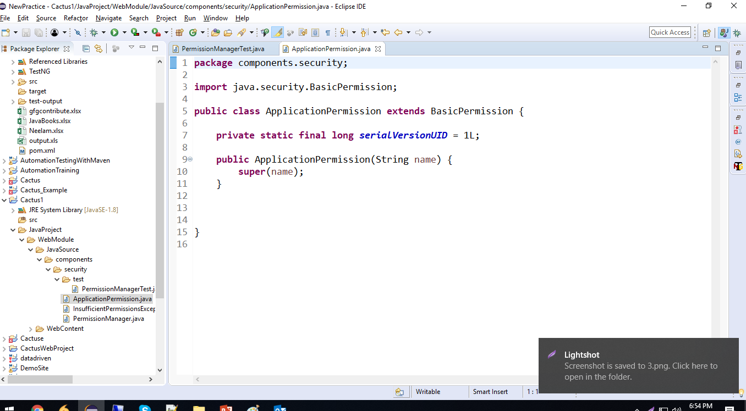
Cactus Example Contd..
Notes:
Below is code for ApplicationPermission.java
package components.security;
import java.security.BasicPermission;
public class ApplicationPermission extends BasicPermission {
private static final long serialVersionUID = 1L;
public ApplicationPermission(String name) {
super(name);
}}

Slide 47
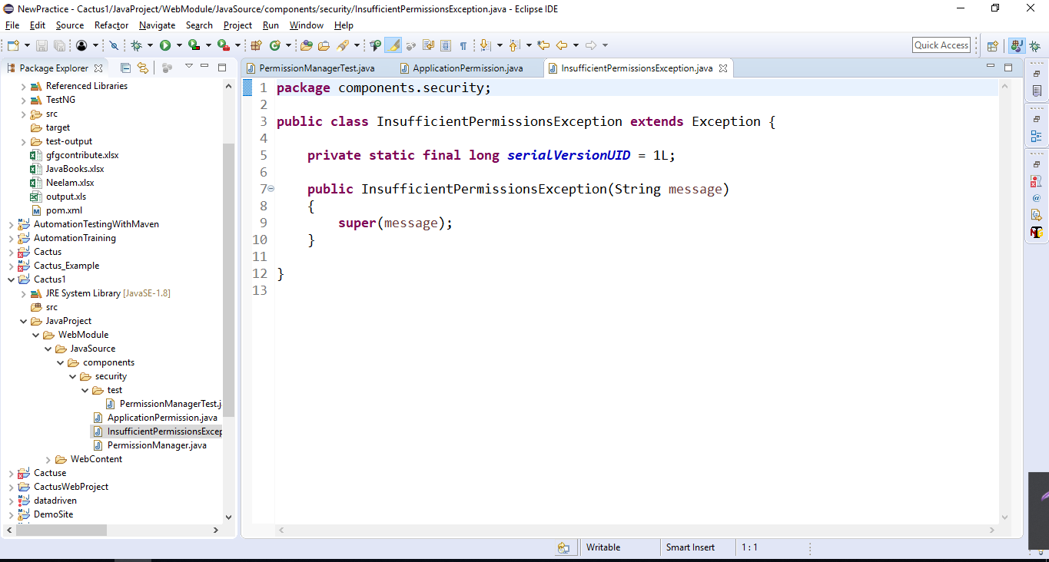
Cactus Example Contd..
InsufficientPermissionException is a custom exception class which has validate method for storing TOKEN_KEY attribute in session means if token gets matched then permission is allowed else InsufficientPermissionsExcetion will be thrown.
Notes:
Below is the code for InsufficientPermissionsException.java
package components.security;
public class InsufficientPermissionsException extends Exception {
private static final long serialVersionUID = 1L;
public InsufficientPermissionsException(String message)
{
super(message);
}}

Slide 48
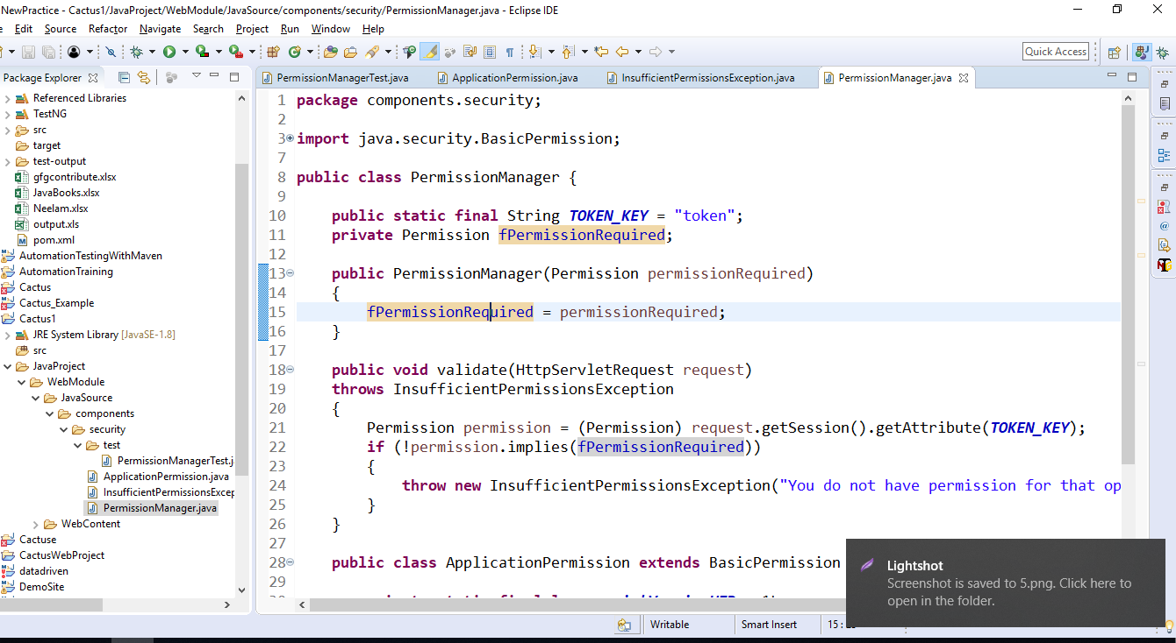
Cactus Example Contd..
Notes:
Below is the code for PermissionManager.java
package components.security;
import java.security.BasicPermission;
import java.security.Permission;
import javax.servlet.http.HttpServletRequest;
public class PermissionManager {
public static final String TOKEN_KEY = "token";
private Permission fPermissionRequired;
public PermissionManager(Permission permissionRequired)
{
fPermissionRequired = permissionRequired;
}
public void validate(HttpServletRequest request)
throws InsufficientPermissionsException
{
Permission permission = (Permission) request.getSession().getAttribute(TOKEN_KEY);
if (!permission.implies(fPermissionRequired))
{
throw new InsufficientPermissionsException("You do not have permission for that operation");
}}
public class ApplicationPermission extends BasicPermission {
private static final long serialVersionUID = 1L;
public ApplicationPermission(String name) {
super(name); }}}

Slide 49
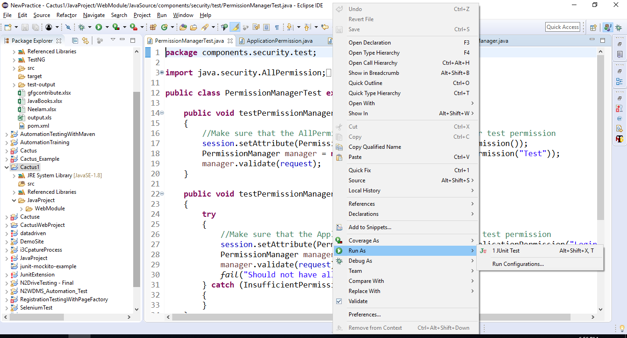
Cactus Example Contd..
Run the project

Slide 50
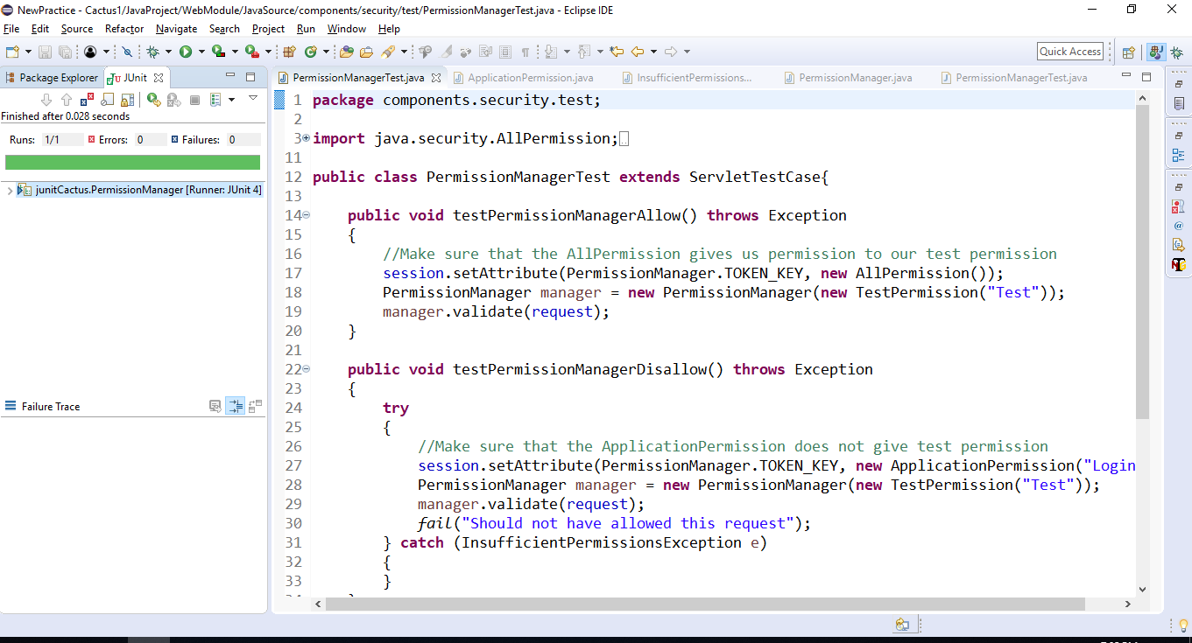
Cactus Example Contd..
The test result shows green success.

Slide 51
Junit Extension Cont..
JWebUnit:
JWebUnit is based on JUnit and helps to write test cases for web applications for their testing.
Using JUnit assertions, navigation & validation of basic web application can be done through API. It supports use of a property file for web resources (a la Struts), though a resource file for the app is not required.
Existing testing frameworks such as HtmlUnit and Selenium gets wrapped with a unified testing interface to test how correct the web applications are.

Slide 52
JWebUnit Example Cont..
package jwebunit.test;
import static net.sourceforge.jwebunit.junit.JWebUnit.assertElementPresent;
import static net.sourceforge.jwebunit.junit.JWebUnit.assertLinkPresent;
import static net.sourceforge.jwebunit.junit.JWebUnit.beginAt;
import static net.sourceforge.jwebunit.junit.JWebUnit.clickElementByXPath;
import static net.sourceforge.jwebunit.junit.JWebUnit.clickLink;
import static net.sourceforge.jwebunit.junit.JWebUnit.getElementById;
import static net.sourceforge.jwebunit.junit.JWebUnit.setBaseUrl;
import static net.sourceforge.jwebunit.junit.JWebUnit.setTextField;
import java.util.List;
import org.junit.Before;
import org.junit.Test;
import net.sourceforge.jwebunit.api.IElement;
public class ExampleWebTestCase{
@Before
public void prepare() {
//setTestingEngineKey(TestingEngineRegistry.TESTING_ENGINE_HTMLUNIT);
setBaseUrl("http://localhost:8080");}
@Test
public void test1() {
beginAt("admin");
//Open the browser on http://localhost:8080/test/home.xhtml
//assertTitleEquals("CMS : Enterprise Web Content Management");
setTextField("loginTextBox", "admin@testmail.com");
setTextField("loginPasswordTextBox", "admin");
clickElementByXPath("/html/body/div[5]/div[2]/div[2]/span/span/span");
assertLinkPresent("goEnterpriseLink");
clickLink("goEnterpriseLink");
assertElementPresent("licenseTabContent");
List<IElement> elems = getElementById("licenseTabContent").getElements("/html/body/div[3]/div[2]/div/div/div[2]/div/div[3]/div[2]/div/div/div/table/tbody/tr[2]/td/div/table/tbody/tr");
for(IElement e : elems){
String e1 = e.getTextContent();
System.out.println(e1);} }}
Notes:
In the above example we used below annotation whose meanings are as follow
@Before: It will run before every test case.
@Test: This is actual test case.
Others are:
@BeforeClass: It is used to write code that we want to run before all test cases.
@After: It will run after every test case.
@AfterClass: It is used to write code that we want to run after all test cases.

Slide 53
Junit Extension Cont..
XMLUnit:
XMLUnit supports JUnit-style assertions for the content. Not only this, the XML structure for testing a system generates and receives custom XML messages.
As per application’s need, we can choose the XML data. In this case, we use the Input class with its array of static methods.

Slide 54
Cont..
XML Unit Example
package learning_tests;
import org.custommonkey.xmlunit.XMLTestCase;
import org.custommonkey.xmlunit.XMLUnit;
import org.junit.Before;
import org.junit.Test;
public class XmlUnitTest {
private XMLTestCase xmlUnit;
@Before
public void setUp() throws Exception {
xmlUnit = new XMLTestCase() {};
}
@Test
public void compareIdenticalXmlStrings() throws Exception {
// GIVEN
String xml1 = "<root><node>Test</node></root>";
String xml2 = "<root><node>Test</node></root>";
// WHEN
xmlUnit.assertXMLEqual(xml1, xml2);
}
@Test
public void compareSimilarXmlStringsWithoutTolerance() throws Exception {
// GIVEN
String xml1 = "<root><node>Test</node></root>";
String xml2 = "<root>\n <node>Test</node>\n</root>";
// WHEN
xmlUnit.assertXMLNotEqual(xml1, xml2);
}
@Test
public void compareSimilarXmlStringsIgnoringWhitespace() throws Exception {
// GIVEN
String xml1 = "<root><node>Test</node></root>";
String xml2 = "<root>\n <node> Test </node>\n</root>";
XMLUnit.setIgnoreWhitespace(true);
// WHEN
xmlUnit.assertXMLEqual(xml1, xml2);
}
}

Slide 55
Junit Extension Cont..
MockObject
Mock objects records the system and tests can validate that.
Mockito is a known mock framework and it can be used in conjunction with JUnit. Mockito helps us to creation and configuration of mock objects. Mockito simplifies the development of tests for classes with externally dependencies significantly.
If you use Mockito in tests you typically:
Mock away all the external dependencies & insert the them into the code under test
Execute the code under test
Validate that the code executed correctly
Mockito provides various methods to create mock objects. mock() creates mocks without consideration about the order or sequence of method calls that the mock is going to make in life cycle of its action.

Slide 56
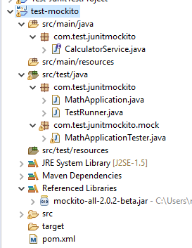
Cont..
package com.test.junitmockito;
public interface CalculatorService {
public double add(double input1, double input2);
public double subtract(double input1, double input2);
public double multiply(double input1, double input2);
public double divide(double input1, double input2);
}
Project Structure
package com.test.junitmockito;
public class MathApplication {
private CalculatorService calcService;
public void setCalculatorService(CalculatorService calcService){
this.calcService = calcService;
}
public double add(double input1, double input2){
return calcService.add(input1, input2);
}
public double subtract(double input1, double input2){
return calcService.subtract(input1, input2);
}
public double multiply(double input1, double input2){
return calcService.multiply(input1, input2);
}
public double divide(double input1, double input2){
return calcService.divide(input1, input2);
}
}
Create Calculator service interface and MathApplication which will implements Calculator Service

Slide 57
MOCK Object Cont..
//subtract the behavior to subtract numbers
when(calcService.subtract(20.0,10.0)).thenReturn(10.0);
//test the subtract functionality
Assert.assertEquals(mathApplication.subtract(20.0, 10.0),10.0,0);
//test the add functionality
Assert.assertEquals(mathApplication.add(20.0, 10.0),30.0,0);
//verify call to calcService is made or not
verify(calcService).add(20.0,10.0);
verify(calcService).subtract(20.0,10.0);
}
}
package com.test.junitmockito.mock;
import org.junit.Assert;
import org.junit.Before;
import org.junit.Test;
import static org.mockito.Mockito.mock;
import static org.mockito.Mockito.verify;
import static org.mockito.Mockito.when;
import com.test.junitmockito.CalculatorService;
import com.test.junitmockito.MathApplication;
public class MathApplicationTester {
private MathApplication mathApplication;
private CalculatorService calcService;
@Before
public void setUp(){
mathApplication = new MathApplication();
calcService = mock(CalculatorService.class);
mathApplication.setCalculatorService(calcService);
}
private CalculatorService mock(Class<CalculatorService> class1) {
// TODO Auto-generated method stub
return null;
}
@Test
public void testAddAndSubtract(){
//add the behavior to add numbers
when(calcService.add(20.0,10.0)).thenReturn(30.0);
Mocking calculatorservice object
Notes:
Create mock objects in many ways:
1) Using the static mock() method.
2) Using the @Mock annotation.
In case of @Mock annotation, the creation of annotated objects must be triggered. Which is allowed by MockitoRule.
It will invoke the static method MockitoAnnotations.initMocks(this)which populates the annotated fields.
Or else you can use @RunWith(MockitoJUnitRunner.class).

Slide 58
Mock Object cotd..
package com.test.junitmockito;
import org.junit.runner.JUnitCore;
import org.junit.runner.Result;
import org.junit.runner.notification.Failure;
import com.test.junitmockito.mock.MathApplicationTester;
public class TestRunner {
public static void main(String[] args) {
Result result = JUnitCore.runClasses(MathApplicationTester.class);
for (Failure failure : result.getFailures()) {
System.out.println(failure.toString());
}
System.out.println(result.wasSuccessful());
}
}
In MathApplication Tester file we use Calculator service class object for mocking and TestRuner class is storing the result of MathApplicationTester class in result object.
When we run above TestRunner file we get output as
true

Slide 59
Summary
In this Module, we have learnt the following:
Writing a Tests
Using Assertion
Execution Procedure
Executing Tests
Suite Test
Ignore Test
Time Test
Exceptions Test
Parameterized Test
Plug with Ant
Plug with Eclipse
Extensions

Slide 60

Thank You

